Slide 1
Introduction to MongoDB
David Green

Slide 2

Agenda
Introduction
Concepts & Fundamentals
Exploring MongoDB (console, Robomongo)
Developing with MongoDB in C#
Advanced Features
Final Remarks
(…and transparent fault tolerance)

Slide 3

About Me
I currently live in Durham, North Carolina with my wife and three kids.
Developer for 15+ years in the MSFT stack (C#, ASP.NET MVC, SQL Server, and etc.)
I like NoSQL and Machine Learning but I hate JavaScript.
Organizer for Raleigh Code Camp and speaker chair Monthly Triangle .NET Meetup Group
One day I will write a book.

Slide 4
THE BIG PICTURE
NOSQL
Redis
Riak
Memcached
CouchDB
RavenDB
RDMS
NewSQL
Hbase
Cassandra
Hypertable
Neo4J
GiraffeDB
InfiniteGraph
All Databases

Slide 5
What is NoSQL?
Martin Fowler: Some characteristics are common amongst these databases, but none are definitional.
Redis
Riak
Memcached
CouchDB
RavenDB
Model not using the SQL language)
Designed to run on large clusters
Not using the relational model
Hbase
Cassandra
Hypertable
Neo4J
GiraffeDB
InfiniteGraph
No schema enforced
Open source

Slide 6
NoSQL DATABASE FAMILIES
Key-Value
Document
Redis
Riak
Memcached
CouchDB
RavenDB
Columnar
Graph
Hbase
Cassandra
Hypertable
Neo4J
GiraffeDB
InfiniteGraph

Slide 7
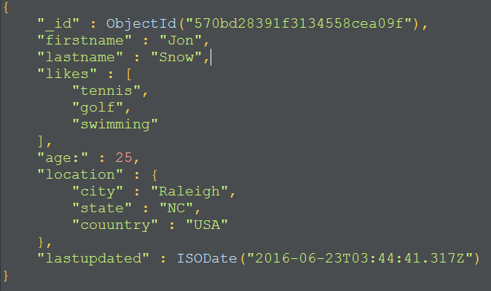
What is MONGODB?
Open source NOSQL database
Document orientated (storing JSON-like documents)
Includes a strong query language (JavaScript)
Scales well horizontally – sharding & replication
Highly available while maintain strong consistency
Cross-Platform (driver support for C#, Java, Python, etc.)

Slide 8
MongoDB 3.2 – a BIG Release
Document Validation
Fast Failover
Simpler Scalability
Aggregation ++
Encryption At Rest
In-Memory Storage Engine
BI Connector
$lookup
MongoDB Compass
APM Integration
Profiler Visualization
Auto Index Builds Backups to File System
Doc-Level Concurrency
Compression
Storage Engine API
≤50 replicas
Auditing ++
Ops Manager
$out
Index Intersection
Text Search
Field-Level Redaction
LDAP & x509
Auditing
Hash-Based Sharding
Roles
Kerberos
On-Prem Monitoring
Agg. Framework
Location-Aware Sharding
2.2
2.4
2.6
3.0
3.2
Notes:
3.2 Document Validation = Data Governance 3.2 Encryption at Rest is huge (but part of Enterprise Version) 3.2 $lookup is huge (joins) 3.2 Compass is a great tools for DevOps (enterprise only). 3.0 Compression in is huge (70% reduction on average!) 3.0 Storage Engine is huge (and allows for In-Memory Storage Engine)

Slide 9
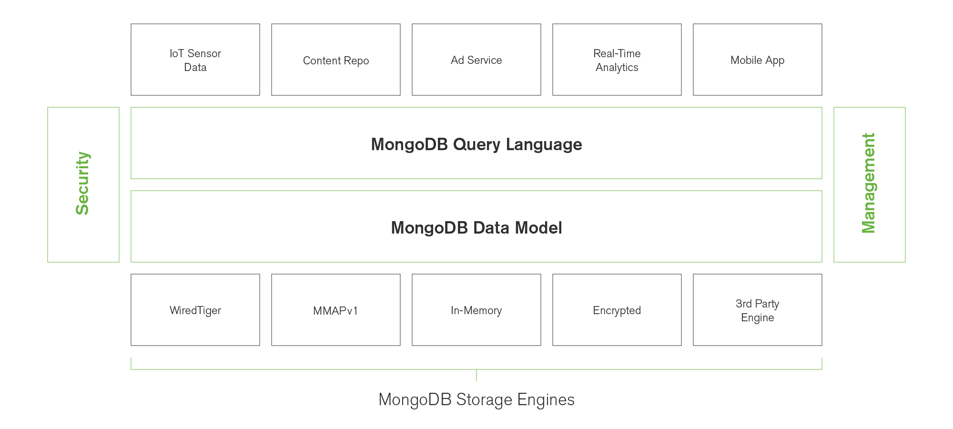
Flexible Storage Architecture in 3.2
Notes:
3.2 Document Validation = Data Governance 3.2 Encryption at Rest is huge (but part of Enterprise Version) 3.2 $lookup is huge (joins) 3.2 Compass is a great tools for DevOps (enterprise only). 3.0 Compression in is huge (70% reduction on average!) 3.0 Storage Engine is huge (and allows for In-Memory Storage Engine)

Slide 10
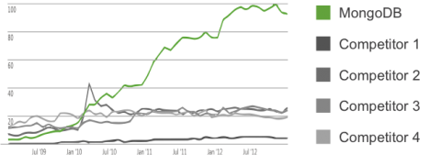
Search Trends – Google
Notes:
3.2 Document Validation = Data Governance 3.2 Encryption at Rest is huge (but part of Enterprise Version) 3.2 $lookup is huge (joins) 3.2 Compass is a great tools for DevOps (enterprise only). 3.0 Compression in is huge (70% reduction on average!) 3.0 Storage Engine is huge (and allows for In-Memory Storage Engine)

Slide 11

Agenda
Introduction
Concepts & Fundamentals
Exploring MongoDB (console, Robomongo)
Developing with MongoDB in C#
Advanced Features
Final Remarks

Slide 12
When you say…IN MONGO IT’s LIKE…
SQL Term | Mongo Term
database | database
table | collection
index | index
row | document
column | field
table joins | embedding & linking
primary key | _id
aggregation (e.g. group by) | map/reduce –or– aggregation pipeline

Slide 13
BSON DATA FORMAT
JSON
BSON = JSON +
Number
String
Boolean
Array
Object
null
ObjectId
DateTime
Byte Arrays
GeoSpatial

Slide 14
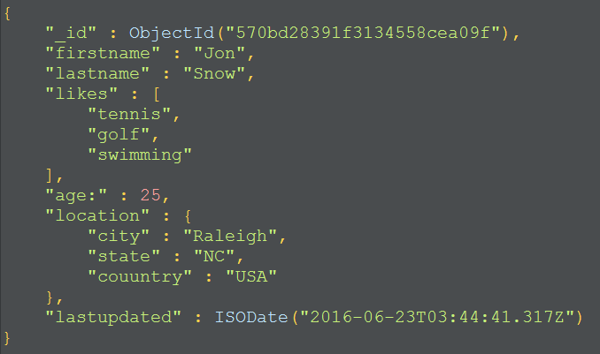
Example BSON Document

Slide 15

Agenda
Introduction
Concepts & Fundamentals
Exploring MongoDB (console, Robomongo)
Developing with MongoDB in C#
Advanced Features
Final Remarks

Slide 16
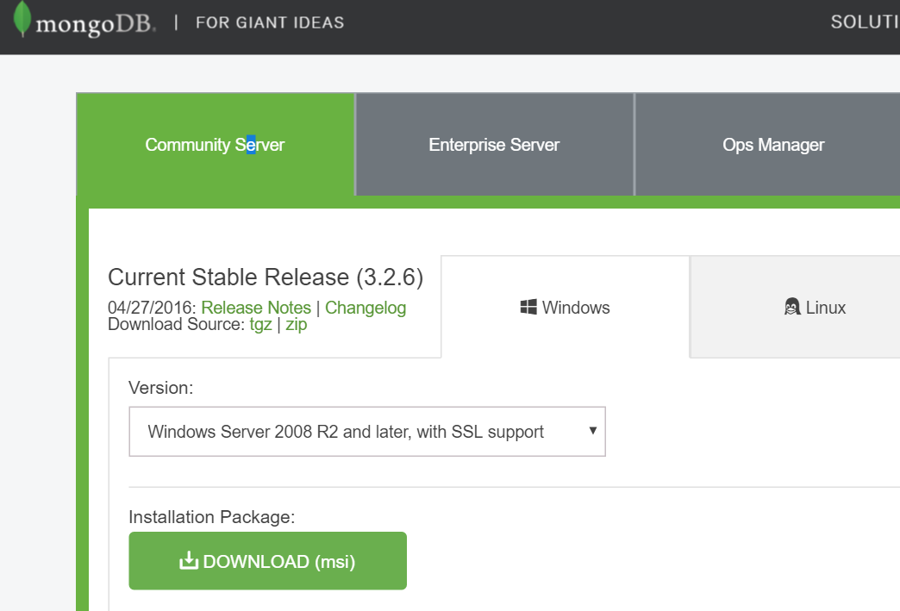
Installing MongoDB
https://www.mongodb.com/download-center#community

Slide 17
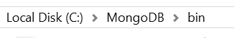
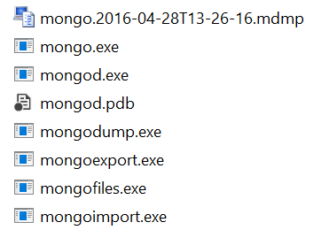
Installing MongoDB (cont’d)
Executables install path
MongoDB interactive console (CLI)
MongoDB server
Running MongoDB server

Slide 18
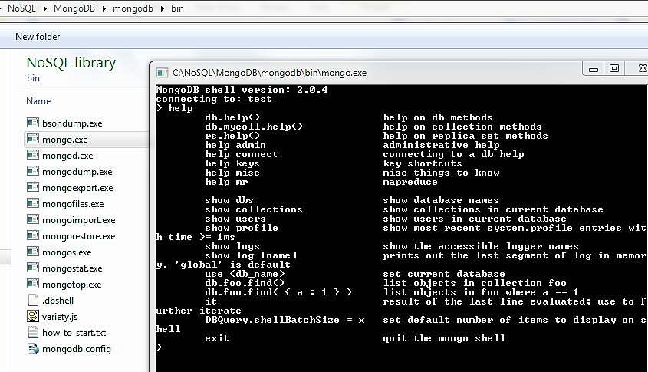
Using the console

Slide 19
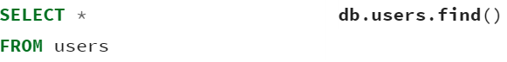
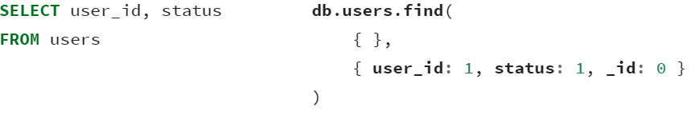
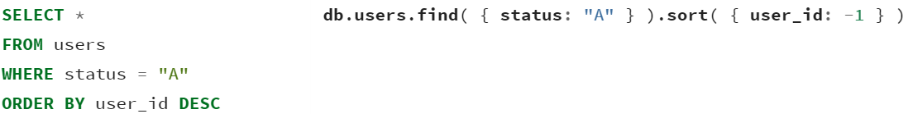
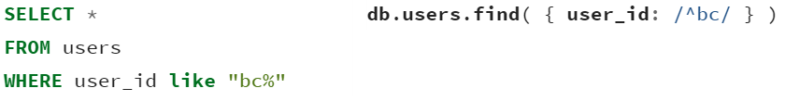
Simple Query Translations
SQL SELECT Statements
MongoDB find() Statements
https://docs.mongodb.com/manual/reference/sql-comparison/

Slide 20
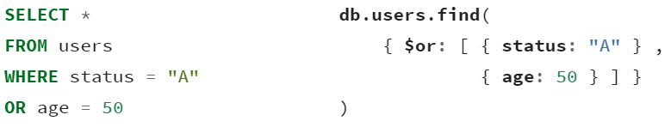
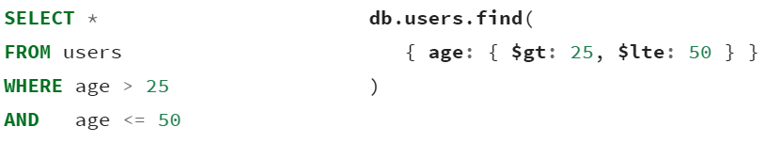
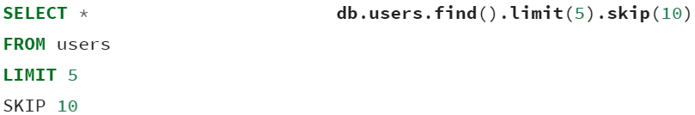
Simple Query Translations (CONT’D)
SQL SELECT Statements
MongoDB find() Statements
https://docs.mongodb.com/manual/reference/sql-comparison/

Slide 21

Agenda
Introduction
Concepts & Fundamentals
Exploring MongoDB (console, Robomongo)
Developing with MongoDB in C#
Advanced Features
Final Remarks

Slide 22
C# DEMO
Basic CRUD examples and aggregation framework example:
https://github.com/davidjeet/MongoDB-Presentation.git

Slide 23

Agenda
Introduction
Concepts & Fundamentals
Exploring MongoDB (console, Robomongo)
Developing with MongoDB in C#
Advanced Features
Final Remarks

Slide 24
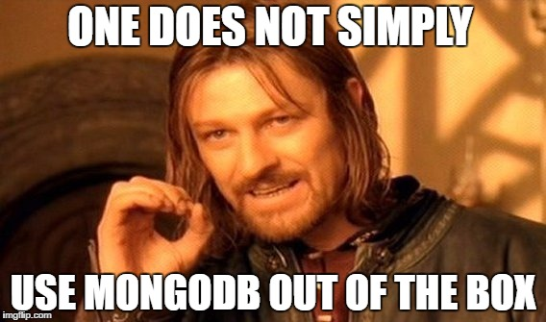
Advanced FEatures
REPLICATION/ SHARDING
JOINS ($lookup)
AGGREGATION
GRIDFS

Slide 25
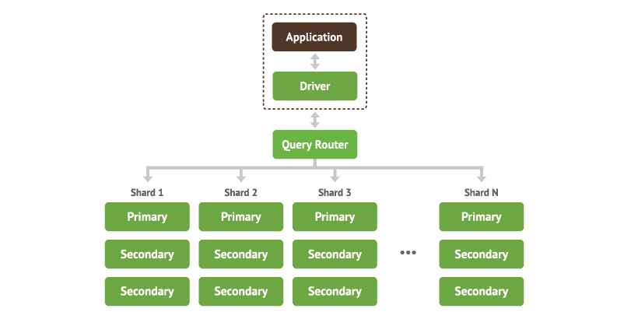
Sharding & Replication
Sharding allows for horizontal scaling (partition tolerance).
Replication allows for high availability.
In combination, the number of servers to manage can grow quite quickly!

Slide 26
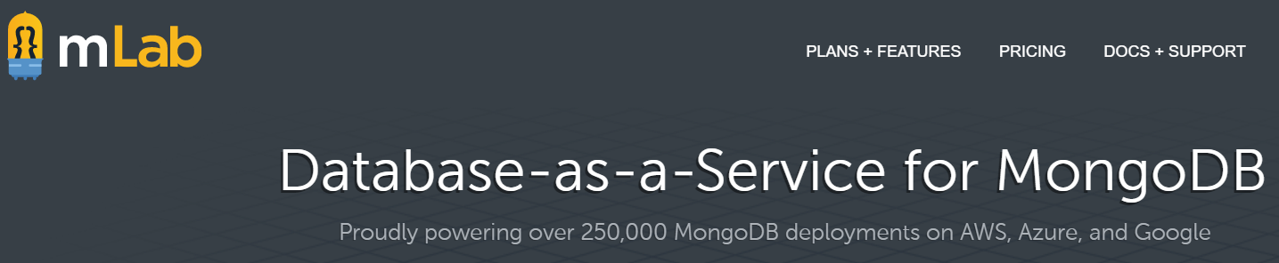
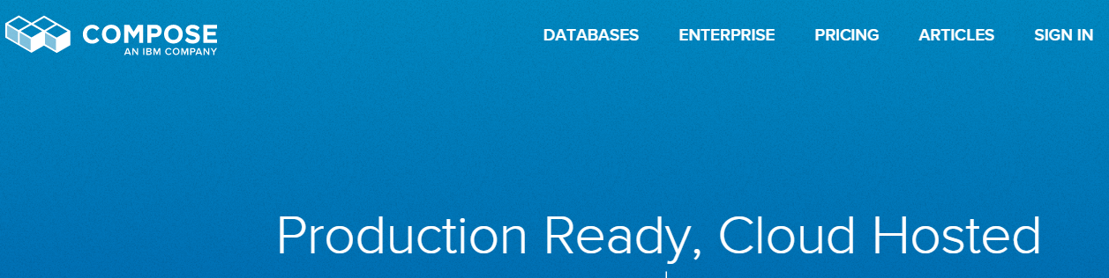
MONGDB AS-a-SERVICE

Slide 27
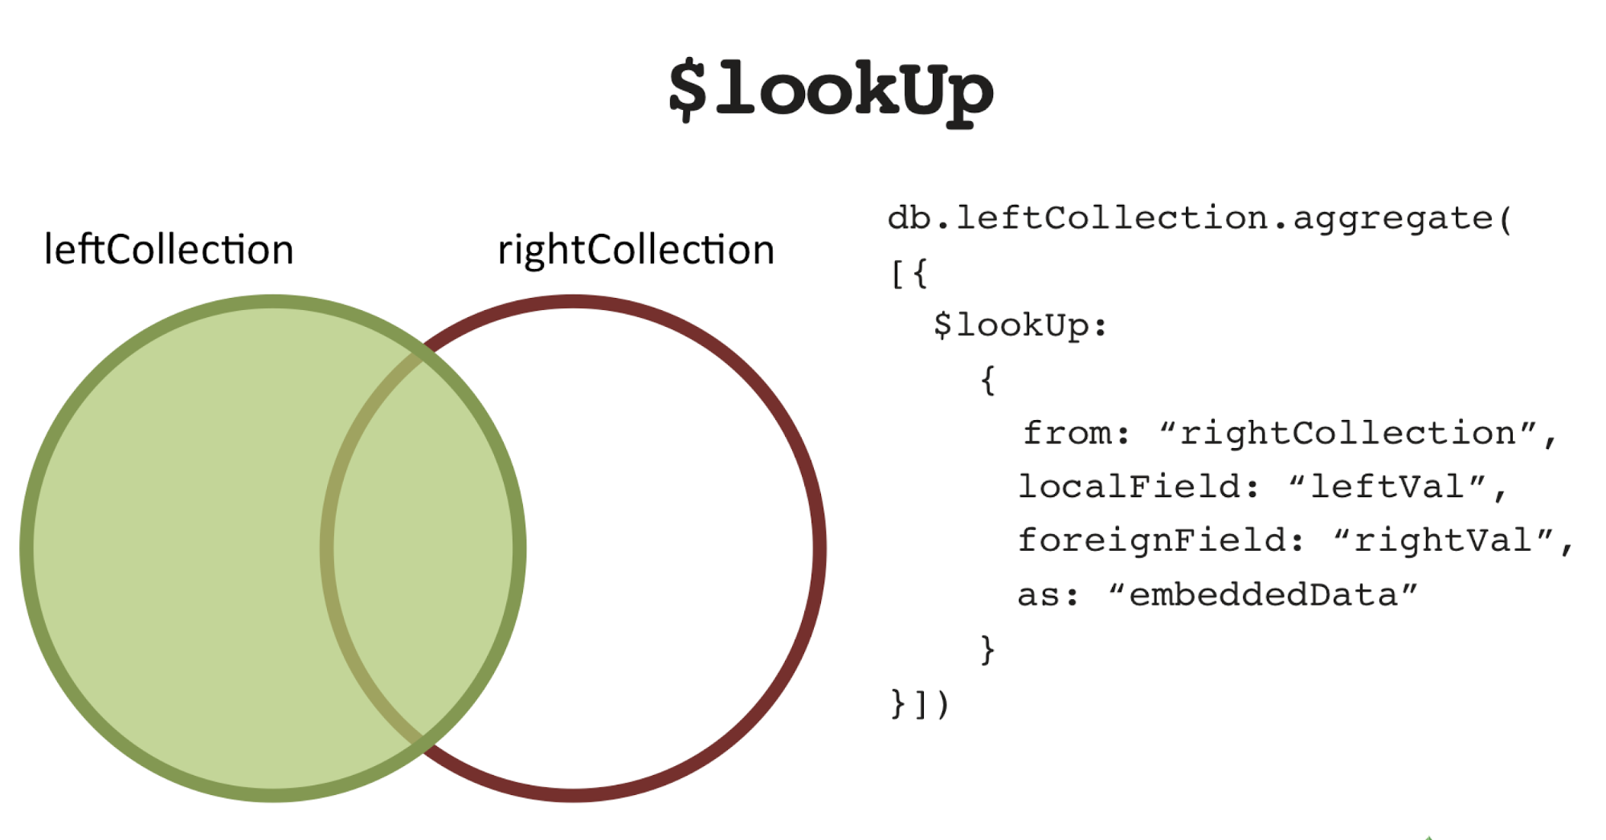
Joins (Mongo v3.2+)

Slide 28
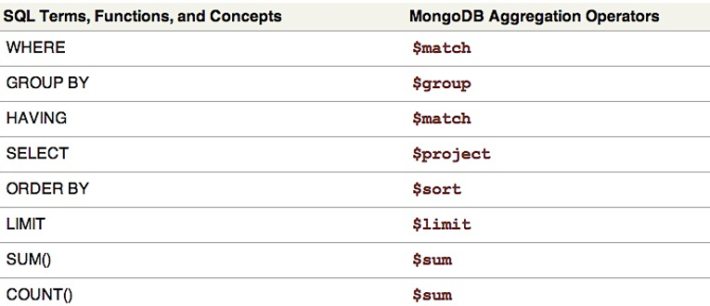
Aggregation Framework

Slide 29
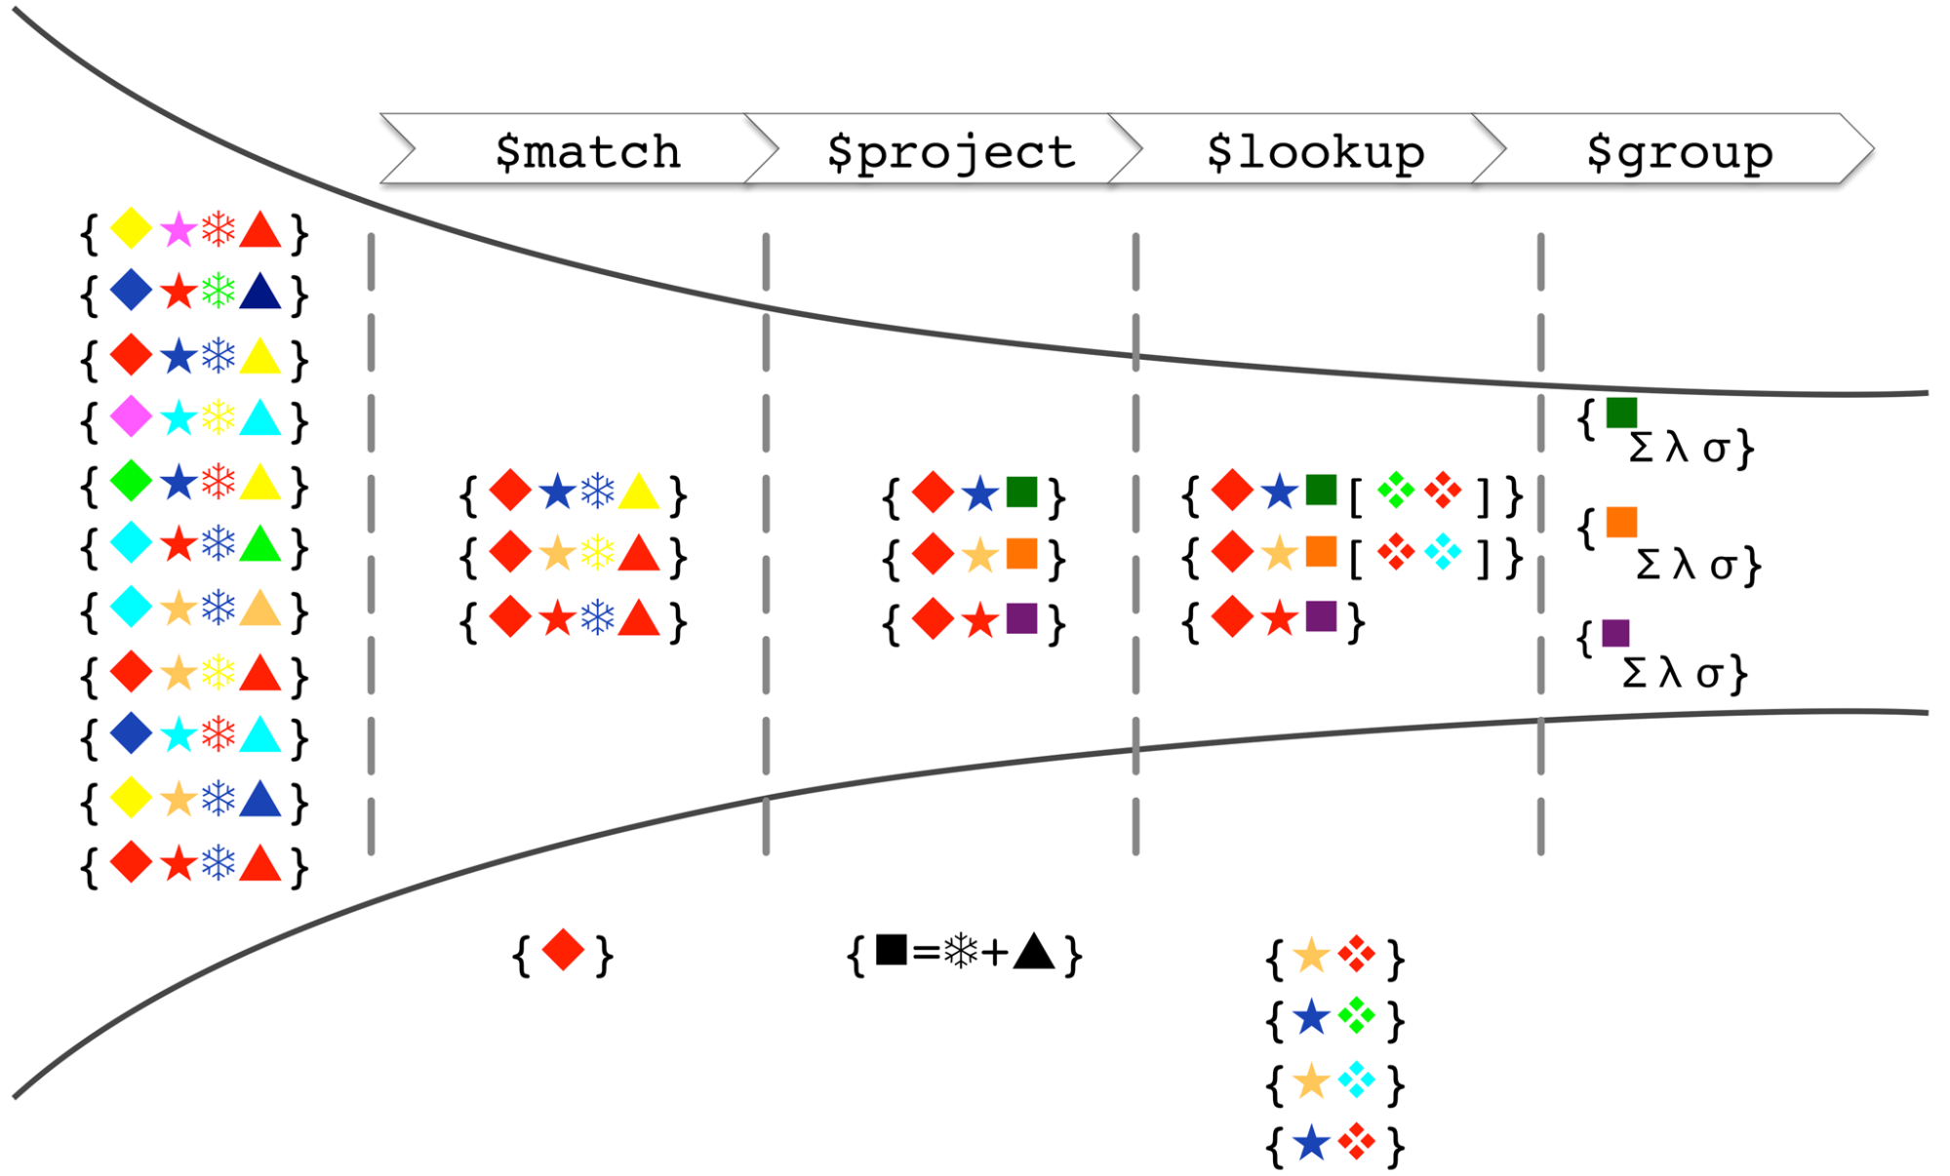
Conceptual Model of Aggregation Framework
Start with the original collection; each record (document) contains a number of shapes (keys), each with a particular color (value)
$match filters out documents that don’t contain a red diamond
$project adds a new “square” attribute with a value computed from the value (color) of the snowflake and triangle attributes

Slide 30
Conceptual Model of Aggregation Framework
$lookup performs a left outer join with another collection, with the star being the comparison key
Finally, the $group stage groups the data by the color of the square and produces statistics for each group
Notes:
$lookup – this creates new documents which contain everything from the previous stage but augmented with data from any document from the second collection containing a matching colored star (i.e., the blue and yellow stars had matching lookup values, whereas the red star had none)

Slide 31
GridFS
GridFS is MongoDB’s way of storing files in the database.
The files are stored in binary chunks that around 256k in size.
File
GridFS
Chunk
Chunk
Chunk
Chunk

Slide 32

Agenda
Introduction
Concepts & Fundamentals
Exploring MongoDB (console, Robomongo)
Developing with MongoDB in C#
Advanced Features
Final Remarks

Slide 33
WHEN TO USE MongoDB?
Data Structure
Document-like
Semi-structured
Few Joins
Geospatial
Data Volume
Large or Huge
Distributed
Unpredictable

Slide 34
MongoDB USE CASES
Document Management systems
E-commerce (catalog portion only)
Archiving / event logging
Real time analytics (based on logging)
Gaming
Geospatial
Mobile

Slide 35
More Information
Contact Info
MongoDB
MongoDB.com
Twitter: @davidjeet
Blog: endgameanalytics.com
LinkedIn: www.linkedin.com/in/nosqlguy
GitHub: github.com/davidjeet
Books MongoDB: The Definitive Guide 2nd Edition (Kristina Chodorow)
Video Tutorials (developers) Pluralsight: Using MongoDB with ASP.NET MVC (Wes Higbee)
Pluralsight: Using the MongoDB C# v2 Driver (Wes Higbee)

